Slide 1
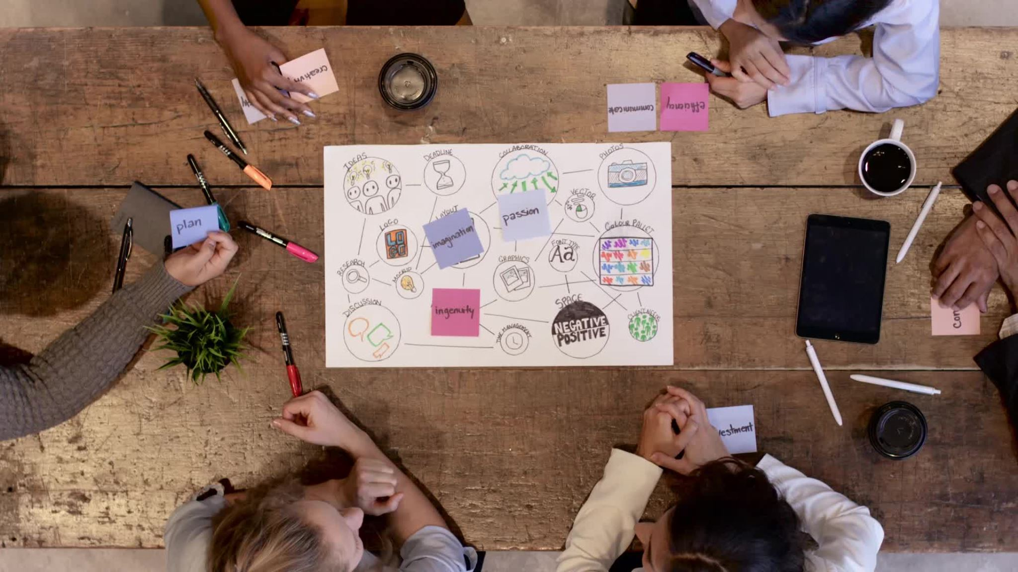
Students Project Management Webapp
Group Id : SPD 12
Name : Chaitanya Sawant
Div : ET-D
Roll NO: 18
Gr. NO: 11910343

Slide 2
Overview
This webapp is for college purpose only. There are mainly two sections Students and Teachers. Students can create project and teachers decide whether to approve that project or not. Students can create tasks for approved projects and only teachers can mark them as complete or not. Students can upload required documents related to projects. Teachers can see them and grade project accordingly.

Slide 3
Features
Two sections Students and Teachers
Students : Main features
1. Login System
2. Edit Profile
3. CRUD operations on projects
4. Create tasks for projects
5. CRUD operations on tasks
6. Upload Documents
Teachers : Main features
1. Login System
2. Edit Profile
3. Approve Projects and Add remarks to projects
4. See tasks and mark them as completed or not
5. See uploaded documents
6. Add marks

Slide 4
Technologies used
Front end : React JS, tailwind CSS
Back end : Node JS, MongoDB, Express JS
Programing Language: JavaScript
Other libraries used: Multer, Nodemon, JWT, Bcrypt, Mongoose, Joi

Slide 5
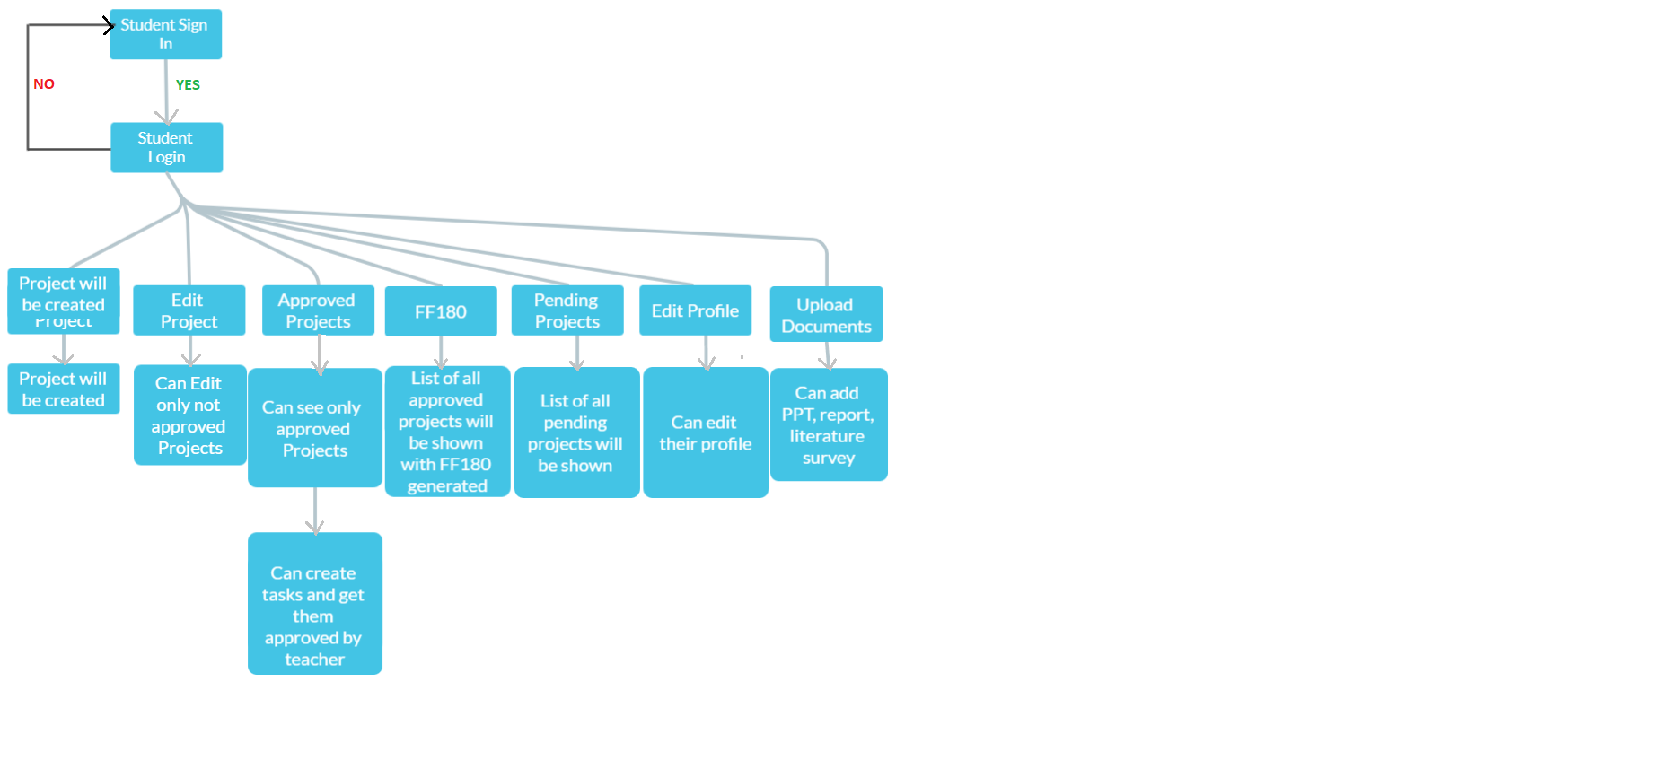
Control flow graph

Slide 6
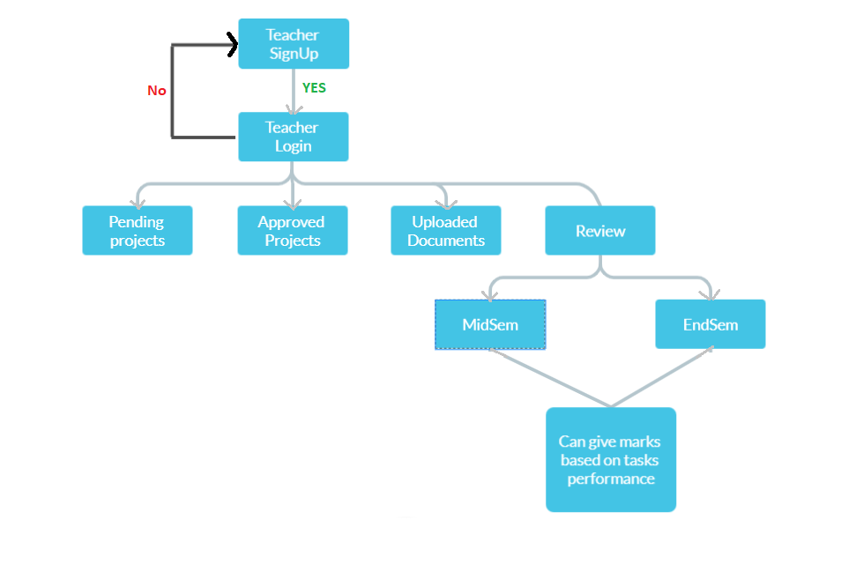
Control flow graph

Slide 7
Time line
Week 1: Finalize topic
1
Week 2 : Search for best technologies with which I can make this project
2
Week 3 : Start working mainly on Backend and bit on front end
3
Week 4 : Finish backend and consume that data on frontend without CSS
4
Week 5 : Apply CSS to frontend
5
Week 6: Try to find bugs and application and fix them
6
Week 7 : Reformat code a bit and Combine with other project
7
Week 8 : After Merging Code with main project fix bugs.
8

